Slide 1
Project Demo-
EMPACT
Date : 07/11/24

Slide 2
Agenda
Project overview
Core features
Technology stack
Architecture overview
Key integrations
Challenges and solutions
Future enhancements

Slide 3
Project Overview
Goal:
To create a comprehensive Learning & Development (L&D) management system that streamlines employee training, tracks development progress, and aligns learning initiatives with organizational goals.

Slide 4
Objectives
Streamline Training Requirements: Provide an intuitive interface for managers to submit training requests and requirements.
Automate Baseline Assessments: Use generative AI to automatically generate relevant assessment questions.
Dynamic Batching: Group employees into training batches based on performance, tailoring training duration and content.
Cost Optimization: Reduce overall training costs by minimizing unnecessary training durations for advanced employees and personalizing training paths.

Slide 5
Core Features
Manager Features:
Adds Requirements
Admin Features:
Offers a range of features designed to streamline and automate the management of training programs within an organization.
Fetch Managers and Training Counts , Detailed Training Requirement Information.
Employee Data Integration, Training Progress Data Retrieval
Other Functionalities:
Cognito-based authentication and secure routing.
AI-Summary Generation
Batch Segregation & Allocation of Trainers Based on Baseline Assessment

Slide 6
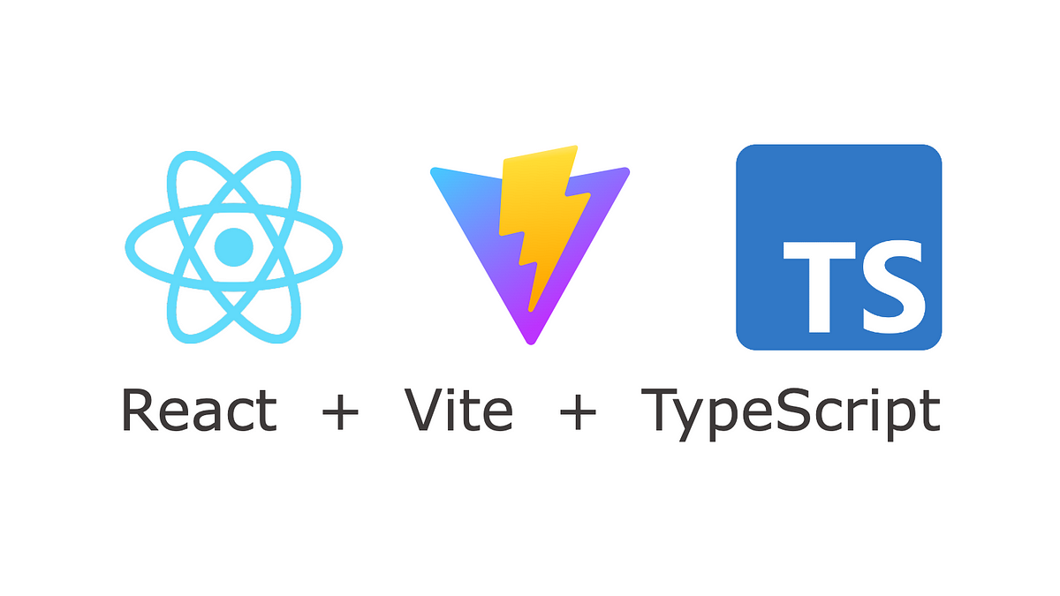
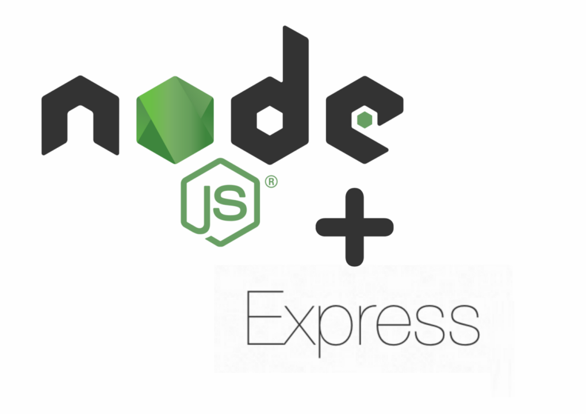
Technology Stack
Frontend:
React with TypeScript and Context API.
Tailwind CSS and Material UI for UI
Backend:
Node.js and Express for REST APIs.

Slide 7
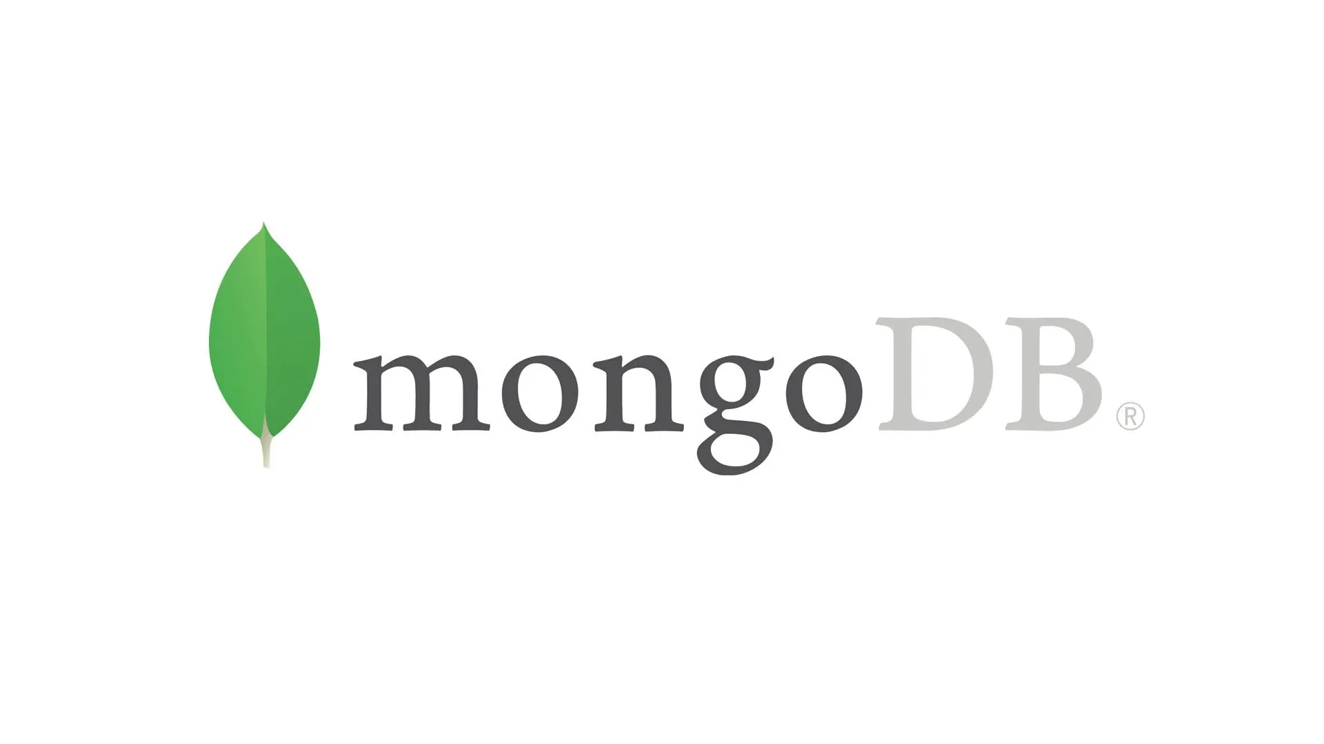
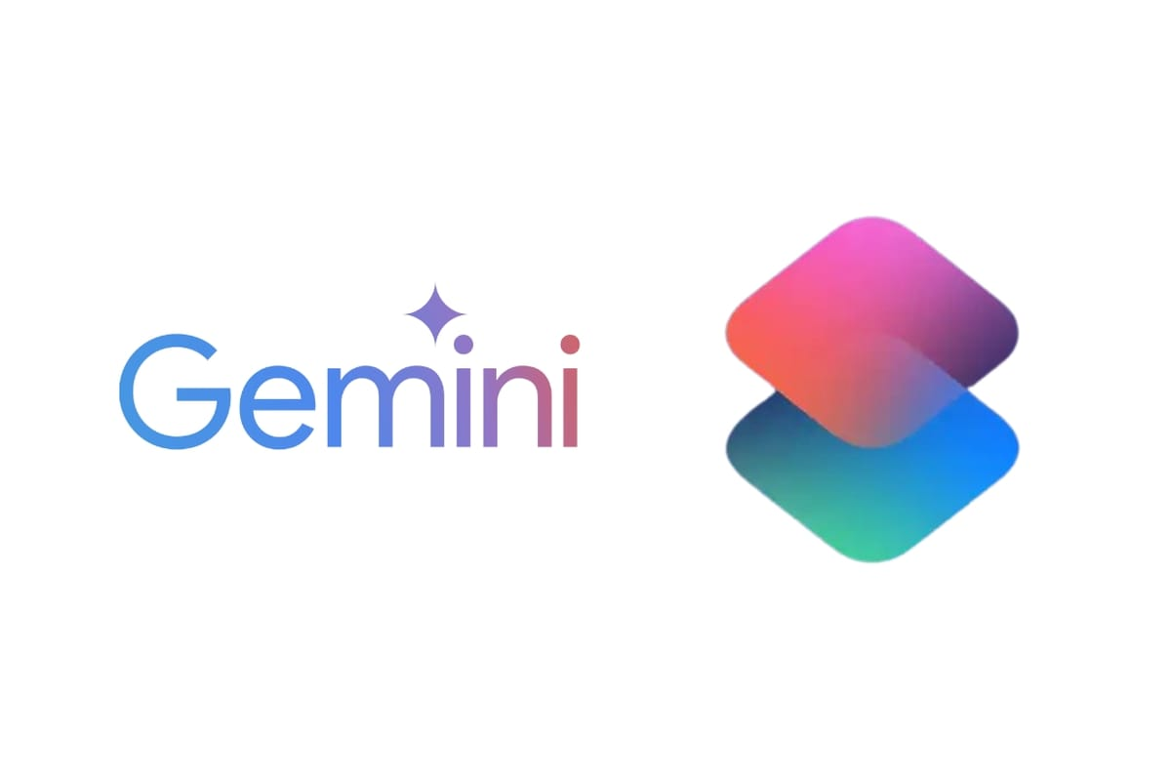
Technology Stack
Database:
MongoDB for document-based storage.
Mongoose for schema modeling.
APIs and AWS Services:
Gemini AI API for AI-Summary
generation.
Cognito for authentication.

Slide 8
Architecture Overview
MERN Stack:
React (Frontend), Express + Node.js (Backend), MongoDB (Database).
Microservices:
Training-Requirement-Management, Ai-Summary, Employee-Management, Trainer-Management, Batch-Management, Training-Progress, Authentication

Slide 9
Key Integrations
Gemini AI API:
It Uses a generative AI model (likely a service like Google’s Gemini) to automatically generate summaries based on training requirement data.
Authentication:
Secures routes using user roles.
AWS Cognito
Stores all the information of the stake holders.

Slide 10
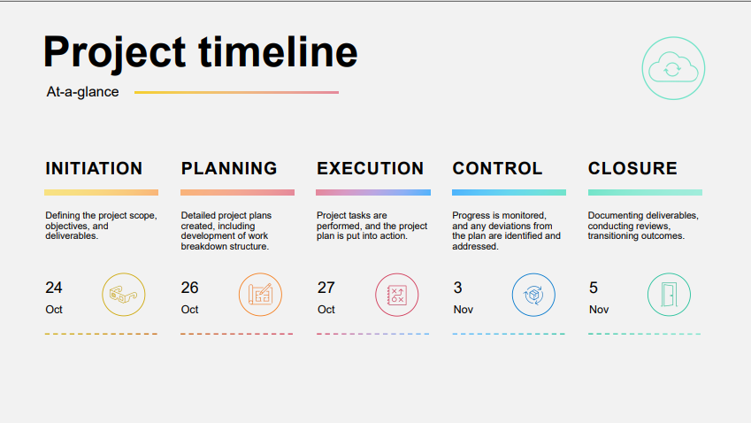

Slide 11
Challenges and Solutions
User Authentication and Authorization Complexity with Cognito
Complex Inter-Service Communication in Distributed Architecture

Slide 12
Future Enhancements
Personalized User Experience with Generative AI
Automated Insights and Reports Using GenAI
Enhanced Manager Verification Using Multi-Factor and Behavioral Authentication

Slide 13
Thank You

